Slide 1

Classification / Prediction

Slide 2
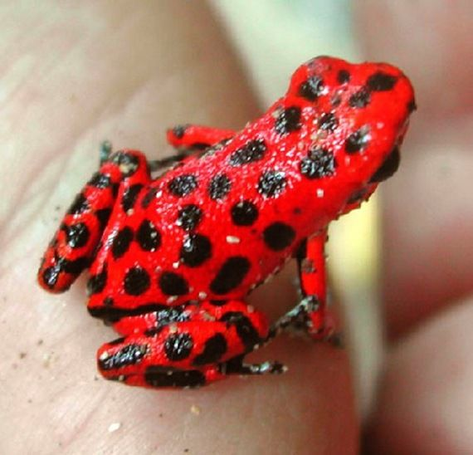
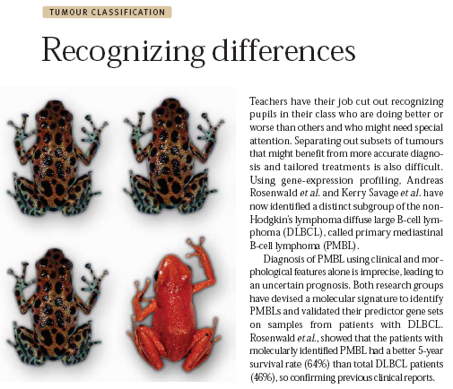
Classification
?
“Supervised Learning”
Use a “training set” of examples to create a model that is able to predict, given an unknown sample, which of two or more classes that sample belongs to.
Notes:
Classification is a type of supervised learning. Given a set a known data a model is created to predict the class of an unknown sample.
The clustering you just saw was called unsupervised learning. Basically you give the data to the computer and let it figure things out.
Supervised learning means that we provide the computer with some supervision. In this case we give it a set of training data along with the answers we expect it to find
– that is we tell it which frogs are red and which are spotted green.

Slide 3
What we’ll cover
How to build a classifier.
How to evaluate a classifier.
Using GenePattern to classify expression data.

Slide 4
What Is a Classifier
A predictive rule that uses a set of inputs (genes) to predict the values of the output (phenotype).
Known examples (train data) are used to build the predictive rule.
Goal:
Achieve high predictive power.
Avoid over-fitting: i.e. classifier memorizes the training data and is not generalizable to other test data
Notes:
Learn a predictive rule from example
Induction
Space of possible rules reduced based on incoming data. The larger the space the higher the chance for finding one that fits the data (but doesn’t generalize) …

Slide 5
Classification
Computational methodology
Data
Known Classes
Pick Genes
Build Classifier
Test Classifier
Evaluate Classifier
Notes:
Since this is not a full quarter-long graduate class in machine learning we are going to make a few simplifications here;
One that we are only using Genes as the features that the classifier uses
Two that there are only two classes to assign samples to, so everything is either a red frog or a green spotted frog.
The basic approach to making a classifier looks like this;
We pick genes that are strongly correlated with the 2 classes
Then we use those genes to build a classifier – basically code that will make a prediction about which class a sample belongs to
Then we test the classifier, and repeat, iterating until we get a good solution

Slide 6
Classification
Computational methodology
Data
Known Classes
Pick genes
Regression Trees (CART)
Weighted Voting
k-Nearest Neighbors
Support Vector Machines
Build Classifier
Test Classifier
Evaluate Classifier
Notes:
We are first going to focus on building the classifier. GenePattern supports several classification and prediction algorithms such as CART, KNN, SVM
as well as two algorithms specifically geared towards proteomics analysis ( in BlastTrainTest and ModEcoC )

Slide 7
Classifiers
Important issues:
Few cases, many variables (genes)
redundancy: many highly correlated genes.
noise: measurements are very imprecise.
feature selection: reducing the # of genes is a necessity.
Avoid over-fitting
Notes:
In the breast cancer dataset we will be using we have around 60 thousand gene transcripts, but only 50 total samples
Many of those genes are redundant. What this means is that for genes that participate in a biochemical pathway together, they may all move up or down together, so if you have one of those genes in your classifier, adding the others doesn’t really add any additional information to make the decision on, but it might add a bit of noise
So what we need to do is to reduce the number of genes to the smallest number that we can get away with, or more precisely, the smallest set of genes that each contribute more information to make a decision on then they do noise.
We also need to avoid overfitting. This is when a classifier essentially memorizes the inputs. This will work perfectly on your training data, but will generally fail badly when you give it a new test set.
Think of it like this; if you were building a classifier to recognize if the picture of a face is of a male or a female, and it only memorized the faces of the 20 people you gave it pictures of, when you give it a picture of the 21st person it has no way to determine whether it’s a boy or a girl. All it really knows is that this is not a person that it already knows.

Slide 8
k Nearest Neighbors (kNN) Classifier
Example: k=5, 2 genes, 2 classes
project samples in gene space
class black
gene 2
class orange
gene 1
Notes:
So lets start looking at building a classifier using KNN which stands for K nearest neighbors. In this case, K stands for the number of neighbors that we will look at at one time.
We’ll keep this easy to visualize by reducing the number of genes (feature selection) to just 2.
We will start with a training set of data that includes 39 samples which are already known to be either orange or black.
Remember that our classifier normally cannot see the orange or the black. Its colorblind, all it knows is the expression values of gene 1 and gene 2 but since this is our training set and since this is ‘supervised’ learning, we tell it which of our training samples are orange and which are black.
So lets see how this works with our a priori choice to use K = 5, that is we’ll look at the 5 nearest neighbors…

Slide 9
kNN Classifier
Example: k=5, 2 genes, 2 classes
project unknown sample
class black
gene 2
class orange
?
gene 1
Notes:
Given an unknown sample, how can we predict what class it belongs to? What our class

Slide 10
kNN Classifier
Example: K=5, 2 genes, 2 classes
"consult" 5 closest neighbors:
- 3 black
- 2 orange
class black
Distance measures:
Euclidean distance
1-Pearson correlation
…
gene 2
class orange
?
gene 1
Notes:
There are many measures of distance. The most intuitive is Euclidean, which is the geometric distance between 2 points. But correlation is also often used.
In this case, the sample would be labeled as black.

Slide 11
Testing the Classifier
Evaluation on independent test set
Build the classifier on the train set.
Assess prediction performance on test set.
Performance measure
error rate =
# of cases correctly classified
total # of cases
Notes:
So in practice here is what you would do. You would find another set of data, which we’ll call the test set.
For this set we need to know which class, orange or black, a sample belongs to, but we do not use any of these samples when we train our classifier.
What we want is a classifier with good generalization and no overfitting. In practice this means that is makes good predictions and can handle data it has not seen before
The error rate is the best measure of a classifier, simply the number of times it gets the prediction right out of the number of predictions it made

Slide 12
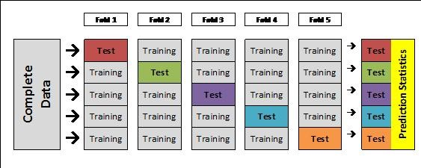
Testing the Classifier
Evaluation on independent test set
What if we don’t have an independent test set?
Cross Validation (XV):
Split the dataset into n folds (e.g., 10 folds of 10 samples each).
For each fold (e.g., for each group of 10 samples),
train (i.e., build model) on n-1 folds (e.g., on 90 samples),
test (i.e., predict) on left-out fold (e.g., on remaining 10 samples).
Combine test results.

Slide 13
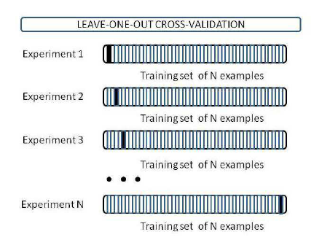
Testing the Classifier
Usually we us leave one out cross-validation

Slide 14
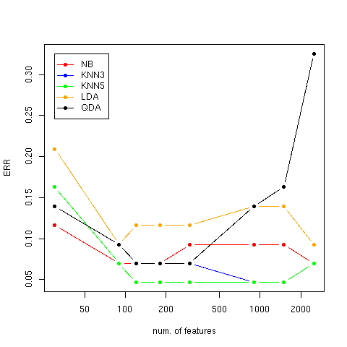
Testing the Classifier
Learning curves – leave one out cross validation
ALL vs. MLL vs. AML
More features are not always better…
Notes:
On ALL/MLL/ALL dataset
Key point – as # features increase accuracy does not but you may be adding noise to the picture
Everyhing will climb as you move out
Low features - miss some intersting stuff
Too many features and you overfit
- since LOO you get better and better training performance but the one prediction gets worse, add genes that are correlated but add nothing to the prediction except noise
Some classifiers are more sensitive to overfitting (eg GDA). KNN is not too bad

Slide 15
Classification Notebook
In the Notebook Repository, locate the notebook titled 2018-01-23_07 UBIC Classification and Prediction – RNAseq
Click on this notebook.
Select “Get a copy”.
Follow along with me

